Slide 1
Transforming Files using Talend Open Studio
February 16, 2018
Presenter:
Copyright © 2014 by Vikram Takkar. All Rights Reserved..

Slide 2
Transforming Files using TOS
Transforming Files:
XML to CSV.
CSV to XML.
JSON to CSV.
CSV to JSON.
Extracting data from
Excel files having single work-sheet.
Excel files having multiple sheets.
Excel file with multiple work-sheets with different schema.
Working with multi-schema delimited files.
Performing lookup operations with Talend Open Studio
Different between tMap and tJoin components.
Different between tMap and tFilterRow components.
Copyright © 2014 by Vikram Takkar. All Rights Reserved..

Slide 3

Transforming XML to CSV.
Lets create a Talend Job to Transform US_STATES.xml and EMPLOYEE_MULTIPLE_NESTED_NODES.xml files to respective CSV files.
Copyright © 2014 by Vikram Takkar. All Rights Reserved..

Slide 4

Transforming CSV to XML.
Lets create a Talend Job to Transform US_STATES_INPUT.csv and EMPLOYEE_MULTIPLE_NESTED_NODES.csv files to respective XML files.
Copyright © 2014 by Vikram Takkar. All Rights Reserved..

Slide 5

Transforming JSON to CSV.
Lets create a Talend Job to Transform EMPLOYEE_INPUT.json to EMPLOYEE_OUTPUT.csv delimited file.
Copyright © 2014 by Vikram Takkar. All Rights Reserved..

Slide 6
Transforming CSV to JSON.
Lets create a Talend Job to Transform EMPLOYEE_OUTPUT.csv that we have just created to EMPLOYEE_OUTPUT.json JSON file.
Copyright © 2014 by Vikram Takkar. All Rights Reserved..

Slide 7

Excel files having single & Multiple work-sheet
Lets create a Talend Job to Extract data from:
EMPLOYEE_INPUT1.xlsx having single worksheet
JOBS_AVERAGE_SALARY_INPUT2.xls having multiple worksheet.
Copyright © 2014 by Vikram Takkar. All Rights Reserved..

Slide 8
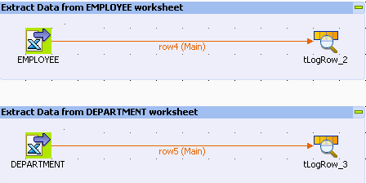
Excel files having Multiple work-sheet with different Schema
Lets create a Talend Job to Extract data from EMPLOYEE_DEPARTMENT_INPUT3.xlsx having multiple worksheet with different schema.
Copyright © 2014 by Vikram Takkar. All Rights Reserved..
Copyright © 2014 by Vikram Takkar. All Rights Reserved..

Slide 9
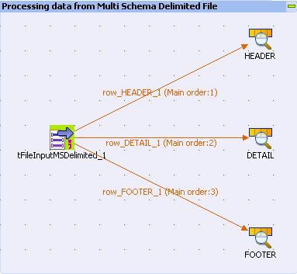
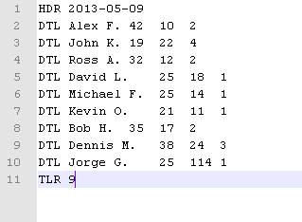
Working with Multi schema Delimited files
Lets create a Talend Job to Extract data from MultiSchema_INPUT.csv having multiple schema in single file.
Copyright © 2014 by Vikram Takkar. All Rights Reserved..

Slide 10
Difference between tMap and tJoin
tJoin and tMap are quite different components, though tMap can be used to perform the same functionality as tJoin. However, tMap is more powerful in terms of functionality. 1. tMap can have many outputs links as compared to tJoin which can have a main and reject links. 2. With tMap we can use expression on the columns while providing the joining condition. I think it is not possible for tJoin, Only exact match between the keys is possible. 3. In tMap we have option to store the intermediate data in the disc. 4. In tMap, we can enable the option to reload the look-up for every record. 5. tMap supports more types of join model, includes unique join, first join and all join, however, tJoin only support unique join. 6. tMap allows you to link multiple look-up flows to it, and supports to load multiple look-up flows parallel, however, tJoin only accept one look-up flow. 7. tMap supports 'die on error' option.
Copyright © 2014 by Vikram Takkar. All Rights Reserved..

Slide 11
Difference between tMap and tFilterRow
Basic difference lies in the purpose and functionality of the components
tMap:
tMap is quite powerful component in terms of functionality as compared to tFilterRow component. Apart from filtering source data it provides lot of other features like lookup, joins etc.
There can be multiple source links to tMap component. One of them is the Main links and all others are Lookup links.
There can be multiple output links/ output data flows from tMap component.
In tMap we can apply transformation to both source and output links.
In tMap, we can transform source column/fields and then apply filter on the transformed column. e.g. We can lookup data from other file based on source field and then apply filter condition to the lookup column which was not present earlier in the source data.
In tMap we can filter data from all the inputs links.
tFilterRow:
Purpose of tFilterRow is to filter the source data based on condition on the source columns.
There can be only one source/input link to tFilterRow Component.
There can be only two output links to tFilterRow i.e. Filter (records that satisfy the filter condition) and Rejects (Records that fails the condition given in the component).
In tFilterRow we can only apply filter condition on source data columns.
In tFilterRow we can not lookup data hence can not apply filter on lookup fields.
In tFilterRow we can not have more than one input links so we can only apply filter condition on one link only.
Copyright © 2014 by Vikram Takkar. All Rights Reserved..

Slide 12
Questions?
Copyright © 2014 by Vikram Takkar. All Rights Reserved..

